Slide 1

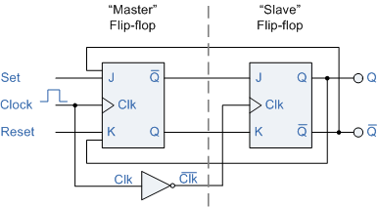
: 8
Lecture: 13
D & T Flip Flop

Slide 2
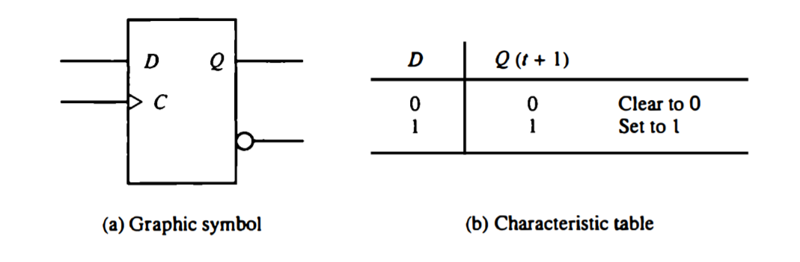
D Flip Flop
  An SR flip-flop is converted to a D flip-flop by inserting an inverter between S and R and assigning the symbol D to the single input.

Slide 3
D Flip Flop
Characteristic Equation:
Q (t+1) = D
  it has the disadvantage that its characteristic table does not have a no change condition Q(t+1) = Q(t). The “no change” condition can be accomplished either by disabling the clock signal or by feeding the output back into the input, so that clock pulses keep the state of the flip flop unchanged.

Slide 4
T Flip Flop
obtained from a JK type when inputs J and K are connected to provide a single input designated by T.
    When T = 0 (J=K=0) a clock transition does not change the state of the flip-flop.
    When T = 1 (J=K=1) a clock transition complements the state of the flip flop.

Slide 5

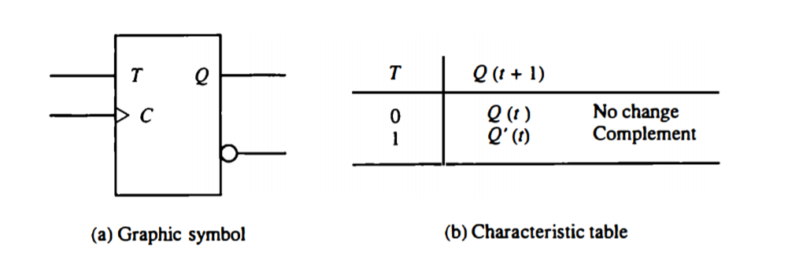
T Flip Flop
Characteristic Equation:

Slide 6
Edge Triggered Flip Flops
  output transitions occur at a specific level of the clock pulse.
  When the pulse input level exceeds this threshold level, the inputs are locked out so that the flip-flop is unresponsive to further changes in inputs until the clock pulse returns to 0 and another pulse occurs.
  Some edge-triggered flip-flops cause a transition on the rising edge of the clock pulse (positive-edge transition) and others cause a transition on the falling edge (negative-edge transition).

Slide 7
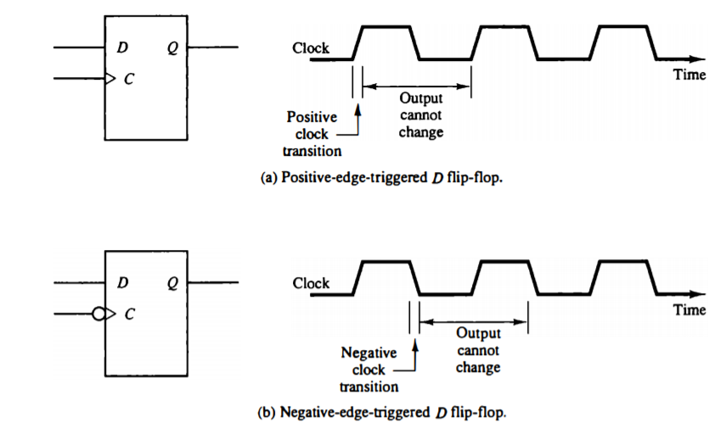
Edge Triggered Flip Flops

Slide 8
Race Around Condition in JK Flip-Flop
    For JK flip flop, if J=K=1 and if CLK=1, for a long period of time, then Q output will toggle as long as CLK is high, which makes the output of the flip flop unstable or uncertain.
      This problem is called race around condition in JK flip flop.

Slide 9
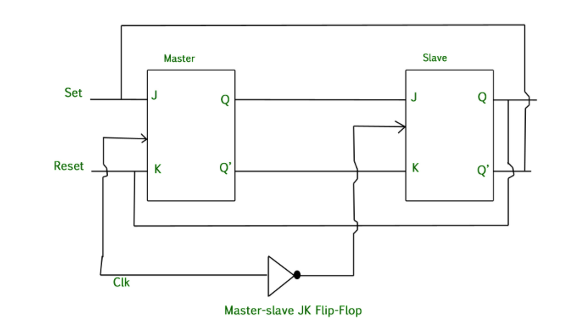
Master Slave JK Flip Flop
  a combination of two JK flip flops connected together in a series configuration. Out of these, one acts as the master and the other as a slave.

